Slide 1
Home Sweet Home
Anthony Stansall
Edward Shafron
Fabio Braga
Tuyet Nguyen

Slide 2
Interactive Dashboard
For this project we use a combination of instructed class materials, including:
Python, APIs, JavaScript, HTML, CSS, D3.js, Anychart.js, Leaflet and SQLite.
For this project we created a dashboard using data source of 700+ records with 250+ different attributes.

Slide 3
Challenges
Allocation and handing-off the work
Different cross origin resource sharing
Merging geojson and json formats while keeping the geojson format for the map

Slide 4
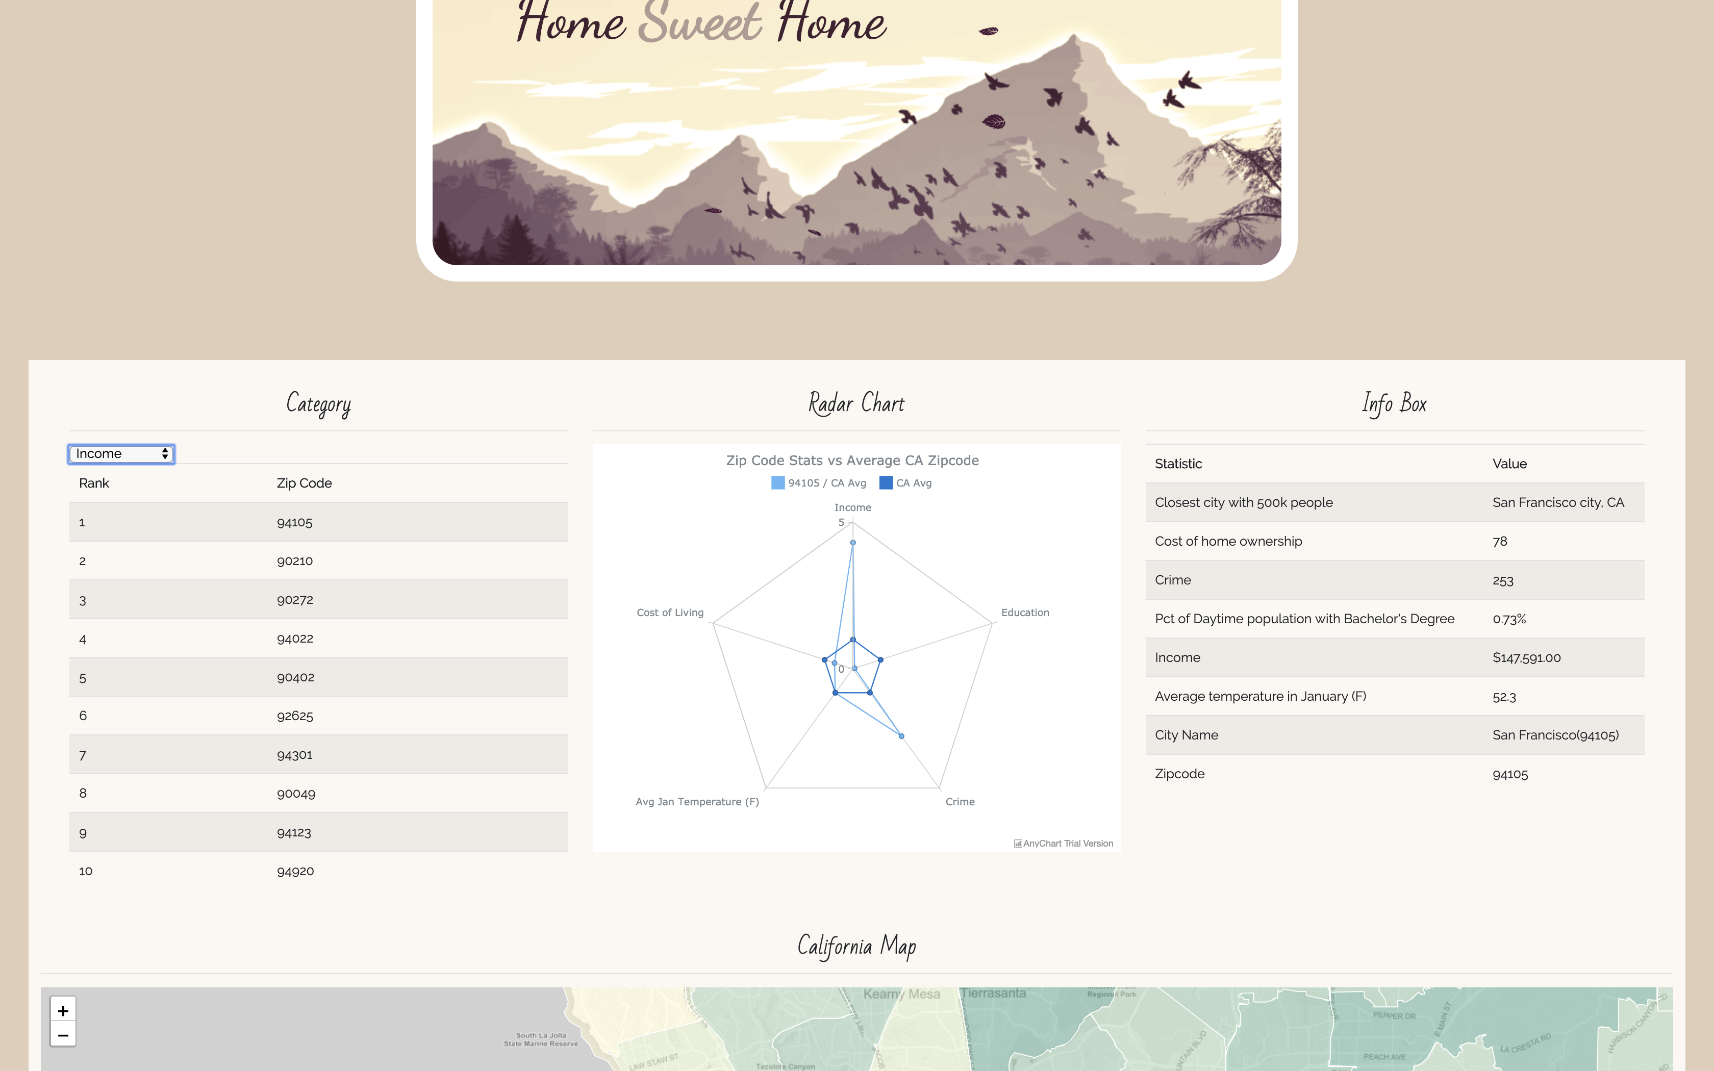
Final Results

Slide 5
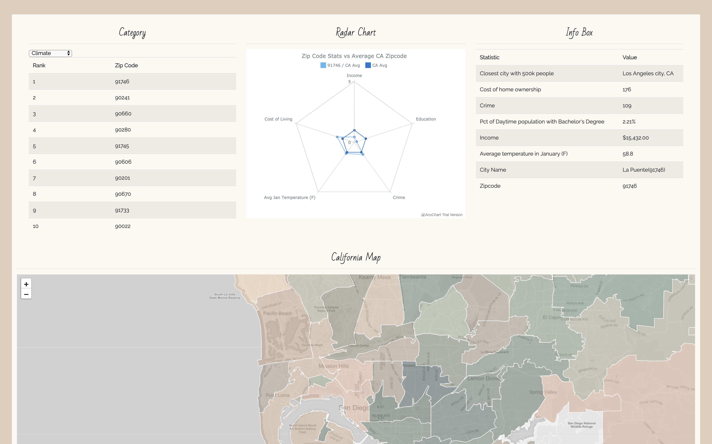
Final Results

